Slide 1

Data Analytics for Secure Decision-Making in Network Management
Done by: Ahmad Obeid
ID: 21110079
Date: August 12, 2023

Slide 2
Introduction
In this assignment, we have a dataset about cyberattacks on some sensor nodes. Our aim to implement the descriptive analytics on that dataset.
Data analytics play a crucial role in network security by providing insights into network behavior, identifying anomalies, and detecting potential threats. By doing analysis we can monitor the network, making decision to protect it against cyberattacks.

Slide 3
Data Analytic Activities, Techniques, and Tools

Slide 4
Data Analytic Activities
Data preprocessing & mining: which done by analyzing and searching in a large dataset, which that what I did in the cyberattacks dataset.
Data exploration: statistical analyzing, understanding, and visualizing the dataset spotting some correlation, I did the activity by applying heatmap to search for correlations between the columns and look up for insights.
Data visualization: representing the data in visual formats like graphs or charts and finding results and relationships. (1)

Slide 5
The techniques used
EDA: understanding the distribution of the data, identifying outliers, anomalies, missing values , or discovering patterns, trends.
Descriptive analysis: examining the data to identify issues and to analyze, describe, and summarize what occurred in the data. supplying perceptions and illustrations of the relationships, outliers, trends, and patterns found in the data.

Slide 6
Tools used
Python: powerful programming language with huge number of powerful libraries, it can be used in analyzing, visualizing the data, and in machine learning model.
Matplotlib: python's 2D plotting package enables the creation of a wide range of static, interactive, and animated representations.
Pandas: strong data analysis and manipulation library. It offers data structures for effectively processing and modifying structured data, particularly DataFrame and Series objects.
Seaborn: Matplotlib-based statistical data visualization package. It offers a higher-level interface for quickly producing visually appealing and informative data visualizations.
For analysts, writing and comprehending code is made simpler by Python's clear and legible syntax. Python is a popular artificial intelligence and machine learning language that is essential to modern data analytics for advanced and predictive analytics. Python provides wide range of libraries that make the process of analyzing easier to the analysts. (4)

Slide 7
Data Analytic Methods
Descriptive Analytics: examining the data to identify issues and to analyze, describe, and summarize what occurred in the data. supplying perceptions and illustrations of the relationships, outliers, trends, and patterns found in the data.
Predictive Analytics: seeks to forecast probable events using past data. Predictive analytics employs probability to make forecasts and extrapolates trends into the future to see potential outcomes.
Prescriptive Analytics: is a sort of analytics that goes beyond forecasting outcomes by also offering best course of actions for how to take advantage of the predictions. (2)

Slide 8
Data Analytics in Industry
Security experts can better comprehend previous trends and events in their network and systems with the use of descriptive analytics. To find abnormalities, trends, and potential vulnerabilities, it entails evaluating log data, user behaviors, network traffic, and system operations. Security teams can better comprehend the threat landscape and acquire insights into historical incidents, such as breaches or attacks, by visualizing these trends.
To foresee future attacks, cybersecurity experts can create predictive models using predictive analytics. These models can offer early warning signs and support organizations in taking preventative action to lessen the impact of assaults.
Prescriptive analytics goes beyond predictive analytics by recommending certain countermeasures to possible dangers. To improve defenses, this can entail advising security setups, patch updates, or network architectural modifications.

Slide 9
Explanation and importance of EDA data analysis
EDA: involves visually and statistically analyzing a dataset understand the distribution of the data, identify outliers, or discover patterns. Also, determining pertinent characteristics or features that have a big impact on the results. Moreover, creates first theories regarding the relationships between the columns.

Slide 10
EDA Techniques used
Scatter plot
Heatmap
Line plot
Count plot
Box plot

Slide 11
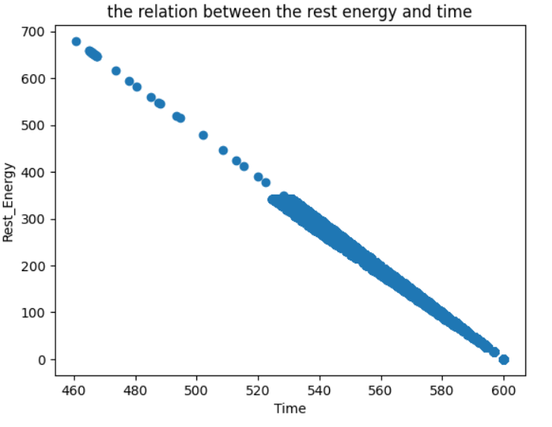
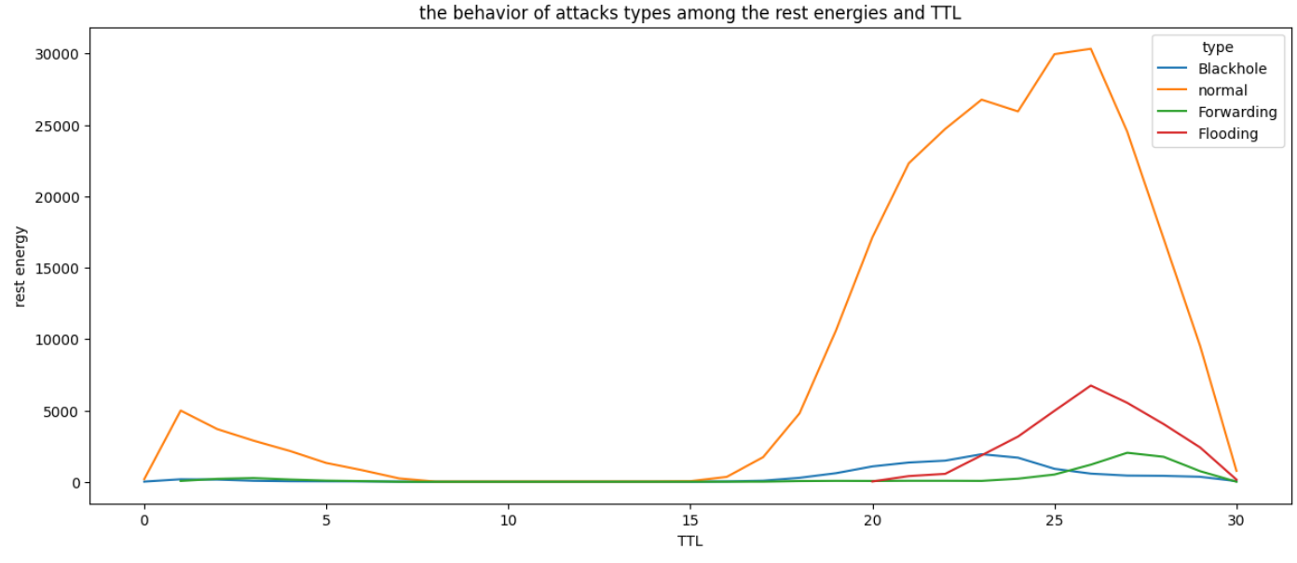
EDA Examples

Slide 12
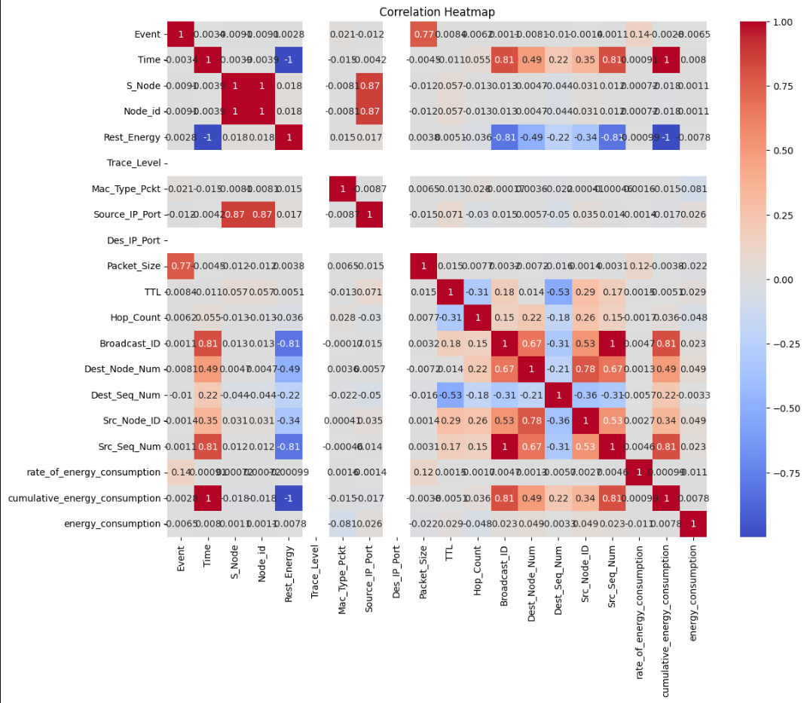
EDA Examples

Slide 13
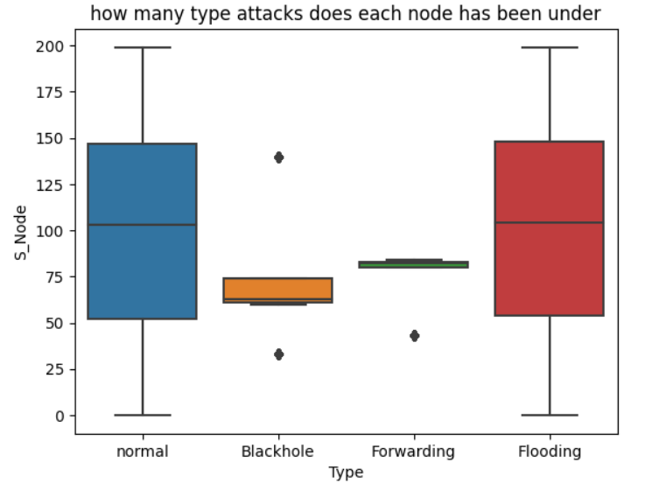
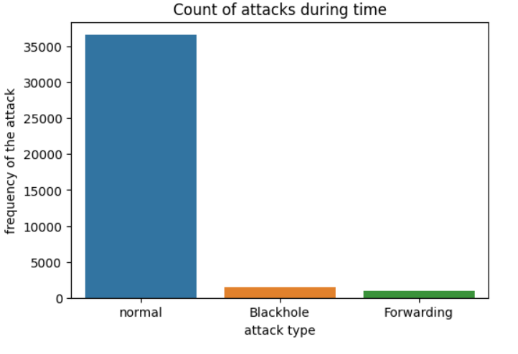
EDA Examples

Slide 14
Descriptive Analytics: Techniques and Decision-Making Importance
Descriptive analytic techniques are ways and measures that help us to examining the data to identify issues and to analyze, describe, and summarize what occurred in the data.
One of the first steps in making a decision is to use descriptive analytics. Reports, KPIs, and business indicators that help us monitor performance and other trends are created using descriptive analytics. Making better-informed judgments that steer the company in the proper path is made easier with its assistance. Simple math, data visualization, and statistical techniques are used by lead to deliver crucial details on how firms operate in general. (3)

Slide 15
Descriptive Analytic Techniques used
Central tendency
Frequency

Slide 16
Feature (Feature.1) Analysis
The first Feature is about the relation between the rest energies and time. First, I used the heatmap to see the correlation between them which is -1. then, I use scatter plot to visualize that relation by plotting these two columns' values to show a pattern.

Slide 17
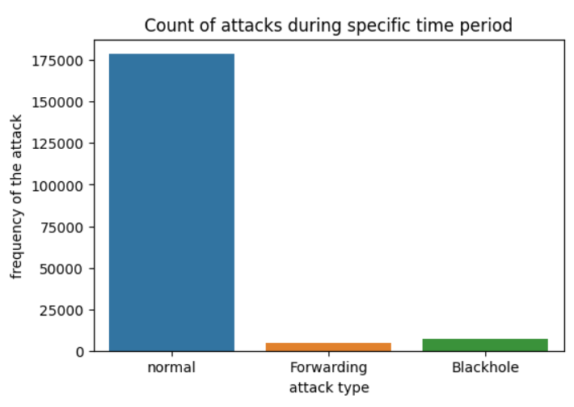
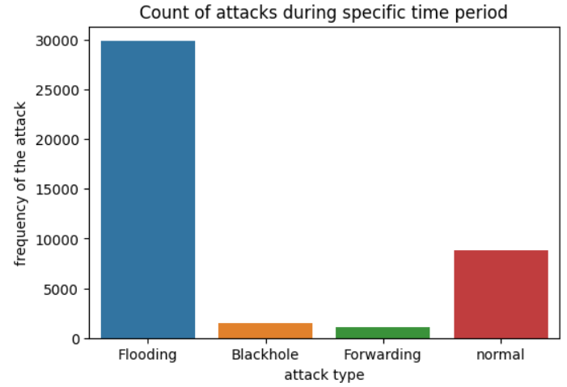
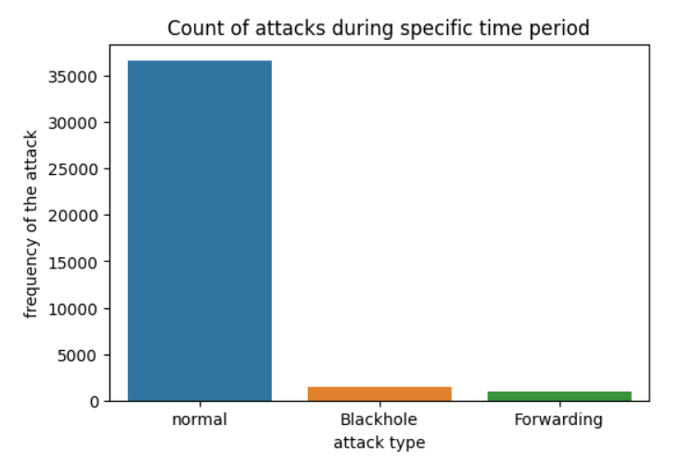
Feature analysis (Feature.2)
This feature is about counting attacks. I used count plot to count the attacks types that occurred in three different time period which are: < 72, > 72 and < 80, and > 80.

Slide 18
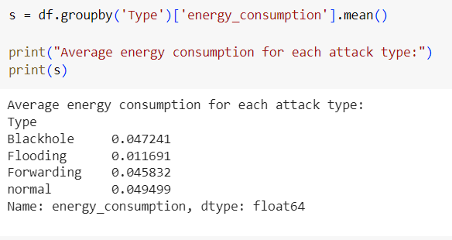
Feature analysis (Feature.3)
The third feature show a relation between type of attacks, rest energies, and TTL. I used line plot to state clearly the behavior of each attack among the energy consumption and TTL, which lead to easy comparison and determine the trends. The second image show the average od energy consumption for each type of attacks

Slide 19
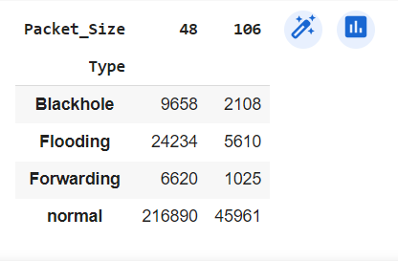
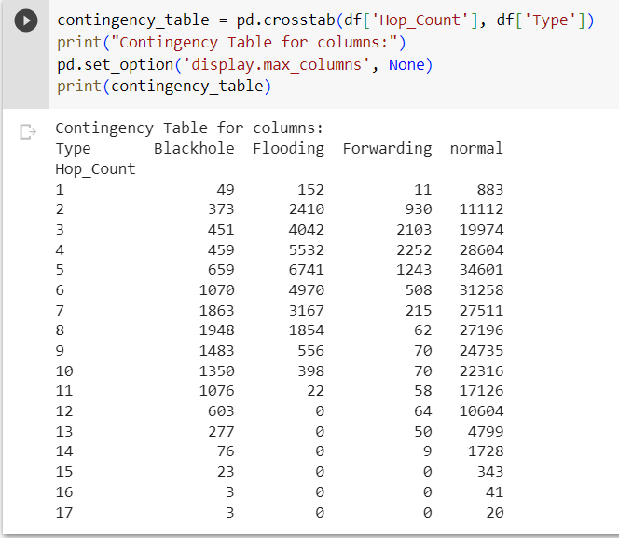
Association Analysis
I did two contingency table. The first one between the packet size and attacks and its aim to see the frequency of the attacks on each packet size. We can see that the packet with size 48 is more danger than packet with 106 size because it contain far more numbers of attacks. The second table is aim to show the frequency of the attacks in each value of the hop count, we can notice that the flooding attacks is end on hop count value (11), not like the rest of the attack which is continue to value (15)

Slide 20
Role of Analysis in Decision Making
In the business in cybersecurity fields, its important to the managers that the data analysts must report them their outcomes in daily base to keep and save that business. When we talk about cybersecurity field, its important to know which attack is dealing the largest damage while comparing with the other, monitoring network traffic, detecting potential dangers and vulnerabilities and sorting them based on their priority. analyzing the data and the selected feature will lead to making decision that benefit the business.

Slide 21
Role of Analysis in Decision Making
Feature (1): we can notice from the heatmap and scatter plot that the correlation between time and rest energies it -1, so its an inverse relationship, which mean by the time increase, the rest energies will decrease and that mean more energy consumption. So, the mangers will benefit from this analysis by seeing which type of attack deal less damage so they can focus on the ones which deal the largest damage.

Slide 22
Role of Analysis in Decision Making
Feature (2): based of the count plot which show the types of attacks that occurred during specific time period, we can see that all flooding attacks occurred in very short time period which is between 72 – 80, which by connecting the insight with feature one, we can say that the flooding attack deal lower damage by consuming less energy than the other attacks, but feature (3) will confirm this theory.

Slide 23
Role of Analysis in Decision Making
Feature (3): we can see in the line plot that the flooding attacks occurred when the value of TTL are between 20-30. Also, we can see clearly that the flooding attack is the least attack in consuming energy, and this outcome agree with feature 2 outcome because the time period for flooding attack is very short. Moreover, another reason why flooding consuming less energy is because of the TTL, we say that the flooding occur when the TTL is above 20 and under 30 and sence the TTL represent how many node does the packet can pass before it dropped, so we can say that more the attack passing node mean more energy consumption, and flooding has less energy consumption because of lower number of nodes it passed which is 10 at the worst-case scenario.

Slide 24
Role of Analysis in Decision Making
So, from that analysis, the managers can focus on the attack with TTL < 20 which are the blackhole and forwarding, also which are deal largest damage specially the forwarding attacks. Also, the prediction to know which attacks will consume more energy and which attacks should we focus on more will become easier, by seeing the TTL value which we explained previously that it has strongly relation with the attacks and energy consumption, it also interpret the behavior of the attack and determine if its urgent or not. Also, as we said that the managers will focus on the attacks with large danger, so from the first contingency table we can predict that the packet with size (48) is likely more danger than size (106) and we should focus on it and track it to avoid these two danger attacks blackhole and forwarding.

Slide 25
Importance of Data Analytical Techniques to Decision-Making
Analyzing the dataset and apply analyzing techniques with descriptive analysis was important in making decision. Analyzing process helps the analyst in understanding the distribution of the data, identifying outliers, or discovering patterns. Also, determining pertinent characteristics or features that have a big impact on the results. Moreover, creates first theories regarding the relationships between the columns. Also, with implementing descriptive analysis, we can identify issues and to analyze, describe, and summarize what occurred in the data. Decision making is based on analyzing process, and in cybersecurity industry, the analyzing process is based on detecting risks and determining the most danger type of attacks which all of these are considered as issues and must deal with them to save the business. The way to deal with them is by making business decisions which the analysts will never be able to make them unless they analyze the data with using appropriate techniques to find some patterns, trends, and insights. In the cybersecurity field, data analytics techniques might influence business decision, like when we found which type of attacks consume less energy which is flooding, so after that we decide to focus on the other type attacks which consume more energy to save the business. We decide to track TTL level, Time, and Packet size and packet size to know if there will be large energy consuming. So, all of these influenced the decision-making process and in that way it significant in that process appears.

Slide 26
References
5 data analytics projects for Beginners (no date) Coursera. Available at: https://www.coursera.org/articles/data-analytics-projects-for-beginners (Accessed: 12 August 2023). (1)
(No date) Types of analytics explained — descriptive, predictive, prescriptive ... Available at: https://business.adobe.com/blog/basics/descriptive-predictive-prescriptive-analytics-explained (Accessed: 11 August 2023). (2)
NetSuite.com (no date) Descriptive Analysis defined, Oracle NetSuite. Available at: https://www.netsuite.com/portal/resource/articles/erp/descriptive-analytics.shtml (Accessed: 11 August 2023). (3)
Terra, J. (2023) Python for data science and data analysis, Simplilearn.com. Available at: https://www.simplilearn.com/why-python-is-essential-for-data-analysis-article (Accessed: 11 August 2023).(4)

